Slide 1

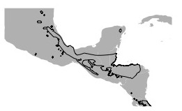






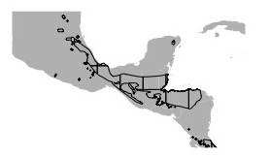
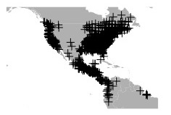
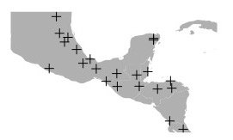
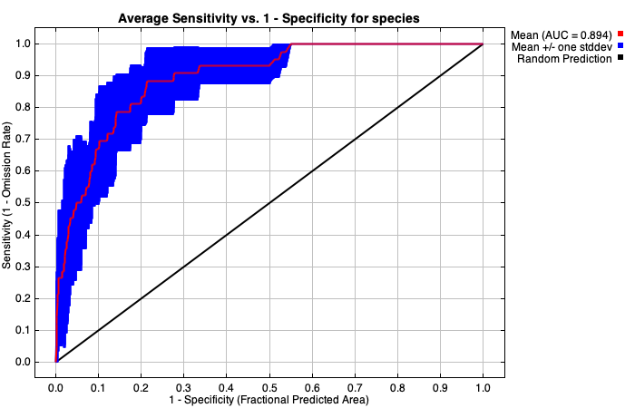
Does climate limit arboreality in lungless salamanders?
Lauren Mellenthin¹, Dean Adams¹, Erica Baken¹
¹Iowa State University, Ames, Iowa
Introduction
There have been ~5 transitions from terrestrial to arboreal microhabitats in plethodontid salamanders
There are no morphological distinctions that separate the two microhabitats (Baken in prep)
Very little range overlap exists between the two habitats provides evidence of separate niches
Our main questions are:
(1) Do arboreal species live in different climatic niches than terrestrial species?
(2) Do these climatic variables sufficiently explain the distribution of arboreality across North, Central, and South America?
Materials & Methods
Polygons & Point Data
Climate Variables &
MAXENT Modeling
IUCN or EOO made Polygons
Biologically informed climate variables
Gridded by 2.5 arc-min Resolution
Point data for microhabitat
Centroid point for gridded cell
Consensus model from 5 replications
Conclusions & Future Directions
Limited by taxonomy changes and occurrence data
More fine scale climate data in species rich areas could corroborate our findings
This study could inform future field research by revealing that arboreal salamanders could be present in locations where we have previously assumed were void of them
These niche models could provide a proxy of which to utilize future climate projection models to estimate if arboreal species face habitat threats
Acknowledgments & Literature Cited
Thanks to the following people: Dr. Dean Adams, Erica Baken, and Bryan Juarez at Iowa State University. Thanks to IUCN for making open access data available. Also to the R packages of MAXENT, dismo, rgdal, and rgeos for modeling platforms.
Lit cited for pictures
Lit cited for Baken in prep
Lit cited for tree

